Slide 1
Applications
Lecture slides for Chapter 12 of Deep Learning
www.deeplearningbook.org
Ian Goodfellow
2018-10-25

Slide 2
Disclaimer
Details of applications change much faster than the underlying conceptual ideas
A printed book is updated on the scale of years, state-of-the-art results come out constantly
These slides are somewhat more up to date
Applications involve much more specific knowledge, the limitations of my own knowledge will be much more apparent in these slides than others

Slide 3
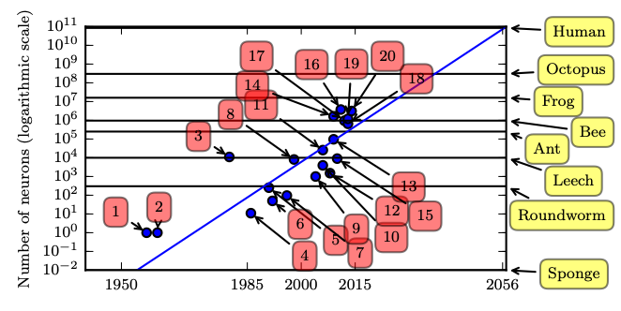
Large Scale Deep Learning
Figure 1.11

Slide 4
Fast Implementations
CPU
Exploit fixed point arithmetic in CPU families where this offers a speedup
Cache-friendly implementations
GPU
High memory bandwidth
No cache
Warps must be synchronized
TPU
Similar to GPU in many respects but faster
Often requires larger batch size
Sometimes requires reduced precision

Slide 5
Distributed Implementations
Distributed
Multi-GPU
Multi-machine
Model parallelism
Data parallelism
Trivial at test time
Synchronous or asynchronous SGD at train time

Slide 6
Synchronous SGD
TensorFlow tutorial

Slide 7
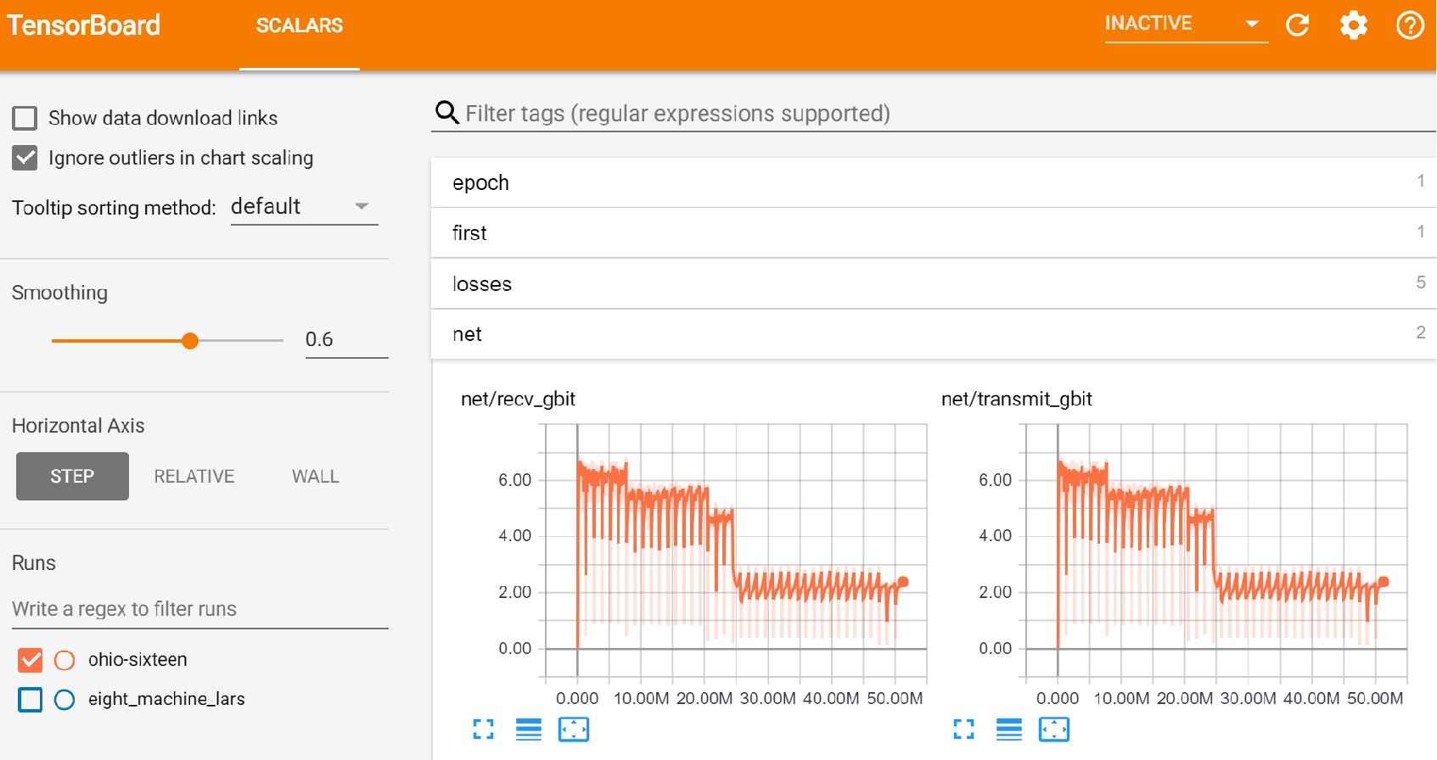
Example: ImageNet in 18 minutes for $40
Blog post

Slide 8
Model Compression
Large models often have lower test error
Very large model trained with dropout
Ensemble of many models
Want small model for low resource use at test time
Train a small model to mimic the large one
Obtains better test error than directly training a small model

Slide 9
Quantization
Important for
mobile deployment
(TensorFlow Lite)

Slide 10
Dynamic Structure: Cascades
(Viola and Jones, 2001)

Slide 11
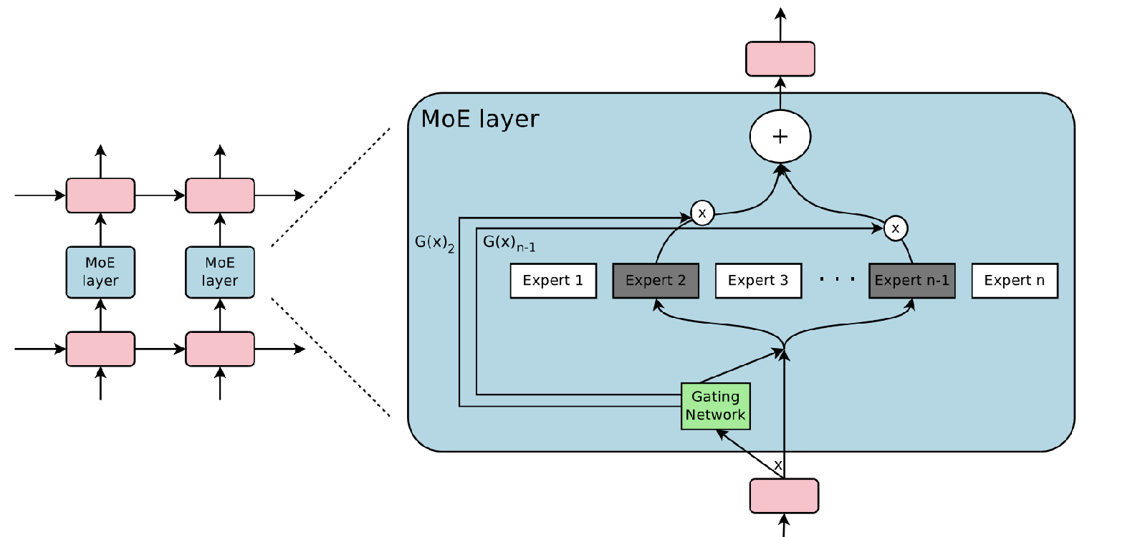
Dynamic Structure
Outrageously Large Neural Networks

Slide 12

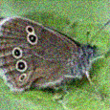
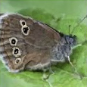


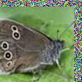

Dataset Augmentation for Computer Vision
Affine Distortion
Elastic Deformation
Noise
Horizontal flip
Random Translation
Hue Shift

Slide 13
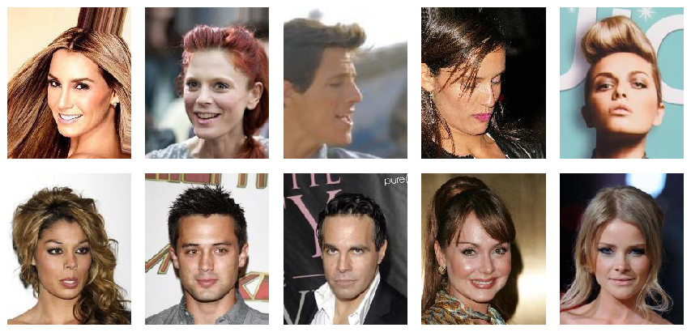
Generative Modeling:
Sample Generation
Training Data
Sample Generator
(CelebA)
(Karras et al, 2017)
Covered in Part III
Progressed rapidly after the book was written
Underlies many graphics and speech applications

Slide 14
Graphics
(Table by Augustus Odena)

Slide 15
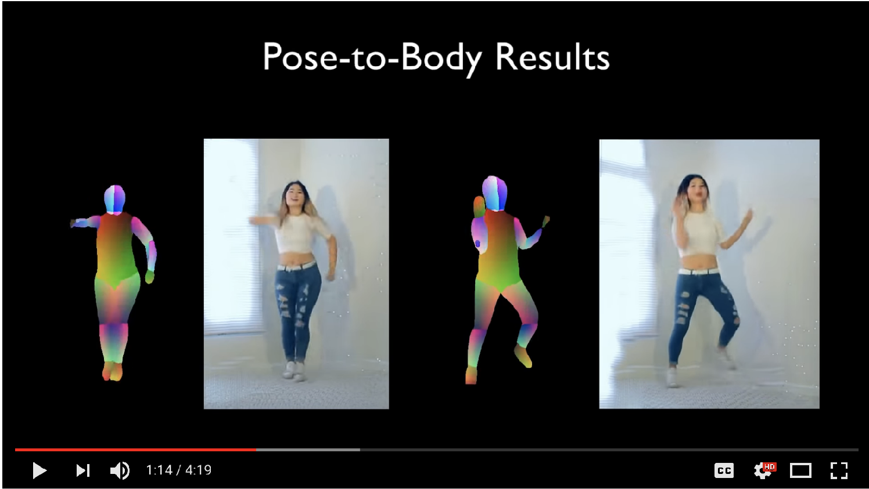
Video Generation
(Wang et al, 2018)

Slide 16
Everybody Dance Now!
(Chan et al 2018)

Slide 17
Designing Physical Objects
(Hwang et al 2018)

Slide 18
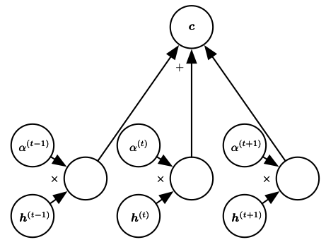
Attention Mechanisms
Figure 12.6
Important in many vision, speech, and NLP applications
Improved rapidly after the book was written

Slide 19
Attention for Images
Attention mechanism from
Wang et al 2018
Image model from Zhang et al 2018

Slide 20
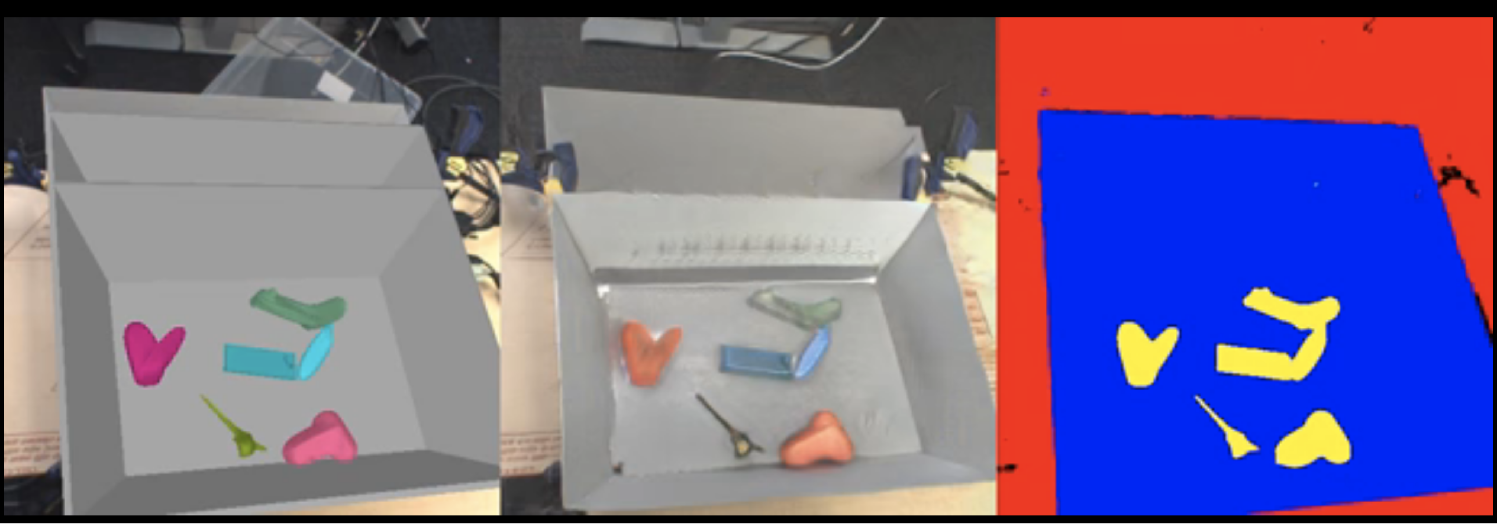
Generating Training Data
(Bousmalis et al, 2017)

Slide 21
Generating Training Data
(Bousmalis et al, 2017)

Slide 22
Natural Language Processing
An important predecessor to deep NLP is the family of models based on n-grams:
Improve with:
-Smoothing
-Backoff
-Word categories

Slide 23
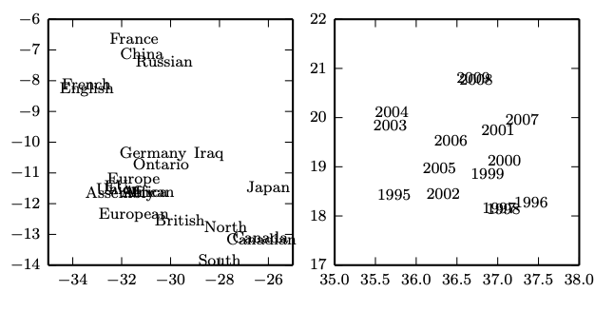
Word Embeddings in Neural Language Models
Figure 12.3

Slide 24
High-Dimensional Output Layers for Large Vocabularies
Short list
Hierarchical softmax
Importance sampling
Noise contrastive estimation

Slide 25
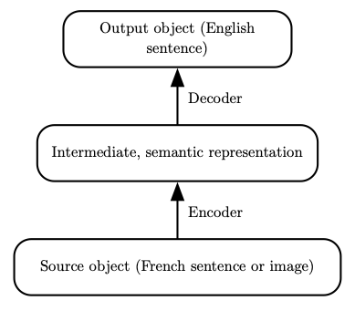
Neural Machine Translation
Figure 12.5

Slide 26
Google Neural Machine Translation
Wu et al 2016

Slide 27
Speech Recognition
Current speech recognition
is based on seq2seq with
attention
Graphic from
“Listen, Attend, and Spell”
Chan et al 2015

Slide 28
Speech Synthesis
WaveNet
(van den Oord et al, 2016)

Slide 29
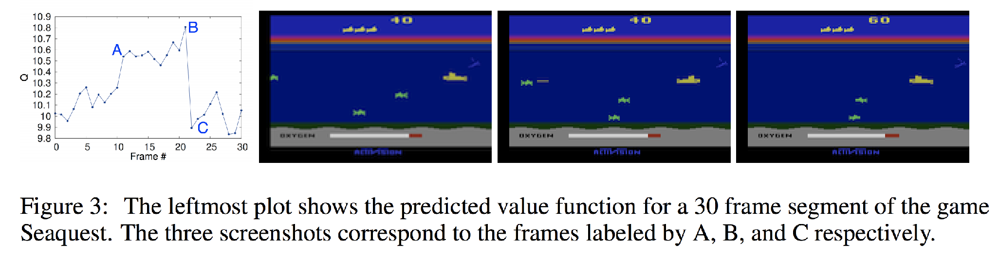
Deep RL for Atari game playing
(Mnih et al 2013)
Convolutional network estimates the value function (future rewards) used to guide the game-playing agent.
(Note: deep RL didn’t really exist when we started the book,
became a success while we were writing it, extremely hot topic by the time the book was printed)

Slide 30
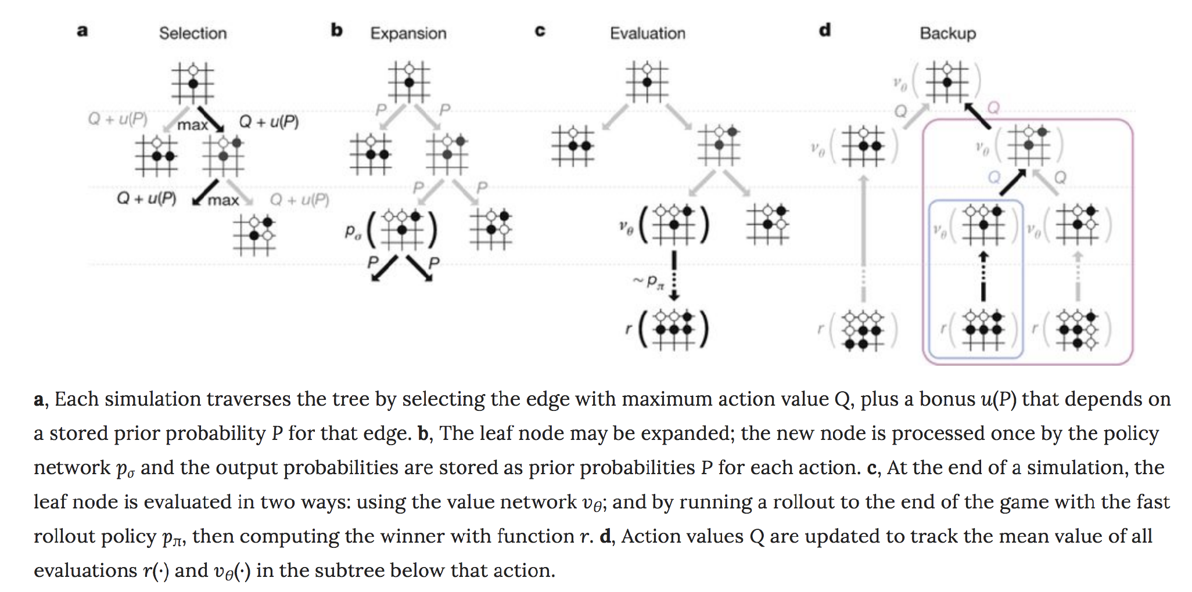
Superhuman Go Performance
Monte Carlo tree search, with convolutional networks for value function and policy
(Silver et al, 2016)

Slide 31
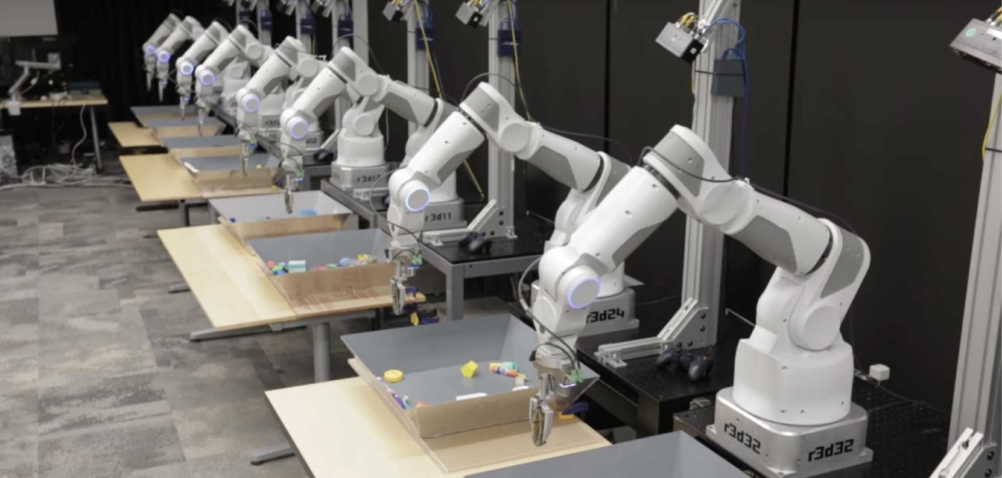
Robotics
(Google Brain)

Slide 32
Healthcare and Biosciences
(Google Brain)

Slide 33
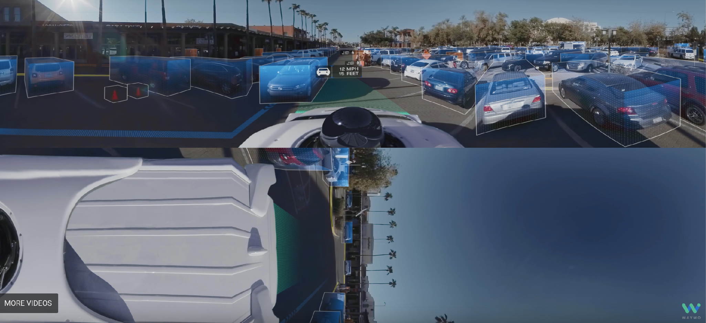
Autonomous Vehicles
(WayMo)

Slide 34
Questions

